Slide 1
Pickens High School Driver Information
Home of the Dragon Nation
Since 1957

Slide 2
Campus Driving regulations
Driving on campus is a privilege that CAN be revoked!
Every driver MUST have a parking pass!
Drivers are required to park in their own assigned parking spot.
Violators can be towed at their own expense.
Do not park in the VISITOR parking spots!
If you are Dual Enrollment/WBL you must park in the front.

Slide 3
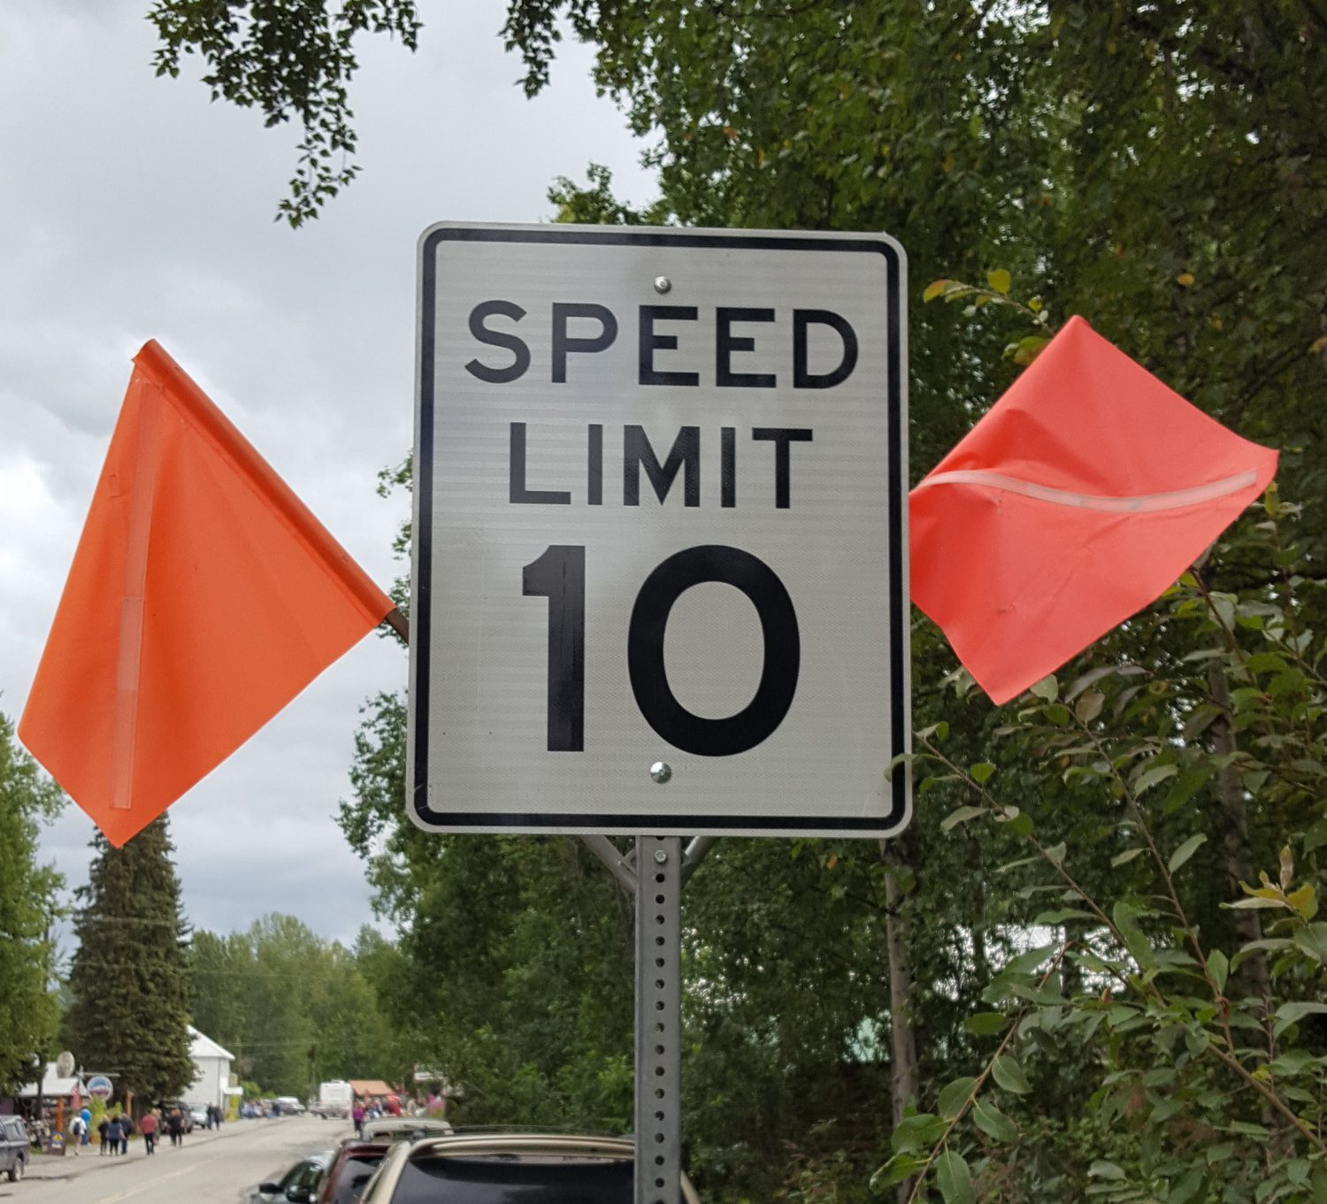
THE SPEED LIMIT ON CAMPUS IS 10 MPH ALL THE TIME!!!
THIS INCLUDES PARENTS!!!

Slide 4
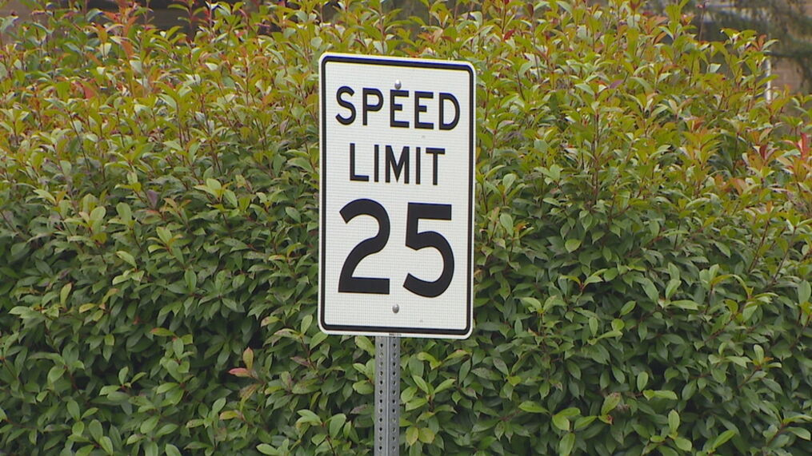
DRAGON DRIVE SPEED LIMIT IS 25

Slide 5
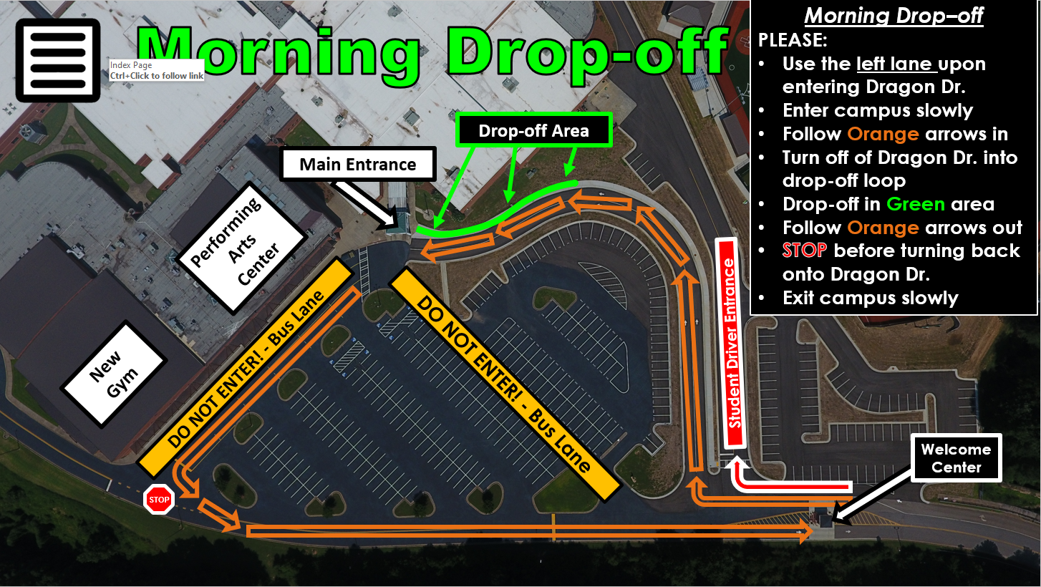

Slide 7
PHS Parking 101

Slide 8
Remember…
On any given day, there are:
- 150-200 Parent Pick-up vehicles
- 30+ School buses
- 300+ Student drivers
- 125 staff vehicles
- Various other vehicles (staff, maintenance, spectators, visitors)
…trying to get onto or out of Dragon Drive between 7:15-7:45 a.m. & 2:45-3:00 p.m. every single day.

Slide 9
Wrecks at 53 & Dragon Drive
Happen 3 Ways:
Failure to Yield onto Dragon Drive or onto 53.
Turning onto Dragon Drive in front of a car traveling toward Jasper on 53.
Rear-ending someone leaving Dragon Drive.

Slide 10
To Jasper
Dragon Drive
To Tate

Slide 11
To Jasper
Dragon Drive
To Tate

Slide 12
To Jasper
Dragon Drive
To Tate

Slide 13
What the Intersection will
look like with new signal

Slide 14
Coming soon to dragon drive
No Turn
Turn

Slide 15
Back Parking Lot Traffic Flow
How it is “SUPPOSED” to work…

Slide 17
Scenario #1
This line is WAAAAAY too long…

Slide 19
Scenario #2
“Dude, I’m with the band…”

Slide 21
Scenario #3
She’s/He’s is looking goooood… So, I am going to be a “nice” girl/guy & let her/him in line…

Slide 23
Band Practice Area
Vehicles must be out of this area by 3:15 p.m. everyday.

Slide 25
DO NOT…
Attempt to drive against traffic
Bark, Squeal, Burn tires
Run through the parking lot
Drive aggressively or Speed
Drive onto the curb or sidewalk
Allow ANYONE to ride on top of, alongside, in the back of, or hang out of your vehicle
Change traffic lanes once committed

Slide 26
Please Do Not…
Have your parent, grandma, boyfriend, girlfriend, best friend, uncle, or anyone else come to the back or sides of the school to pick you up.
Loiter in the parking lot
TEXT & Drive
Get out of your vehicle (unless it is on fire)
Leave your vehicle in the Band practice area

Slide 27
Please Do…
Look for Mr. Goble/Teacher to direct you
Let an adult know if you need assistance, or if you see something unsafe
Be PATIENT!!!
Be Kind
Be Safe
Be Aware
Buckle up
Leave by: 3:00 p.m.

Slide 28
Mornings
Enter by following around the Baseball/Softball Complex (South end of the school).
Once on campus, you are expected to enter the building and report to cafeteria or Old PAC (if before 7:35 a.m.)
Be cautious of those walking to the building
If you are here early (test make-up, tutoring, etc.), you MUST have a pass from your teacher.

Slide 29
How to lose your driving privilege...
Leave campus without permission
Speeding or Aggressive Driving
Driving against traffic flow
Failing to leave campus (Loitering)
Allowing someone to ride on, alongside, in the bed of, or hanging out of your vehicle.
Failure to wear seatbelt
In possession of illegal items in your vehicle
Going to your car without permission
Poor Attendance/Tardies

Slide 30
Thank you for being attentive!
BE SAFE!

